Slide 1
LeeAnne Walters
Flint citizen scientist, whistleblower and Goldman Environmental Prize awardee

Slide 2

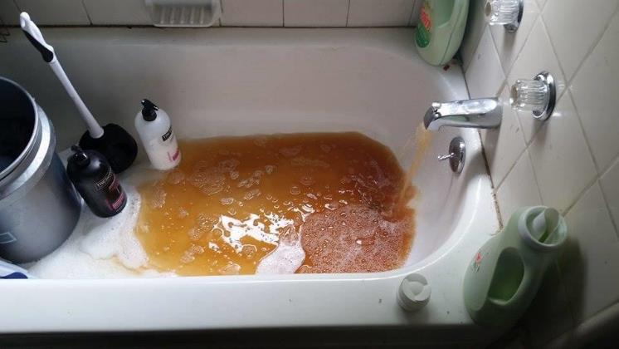
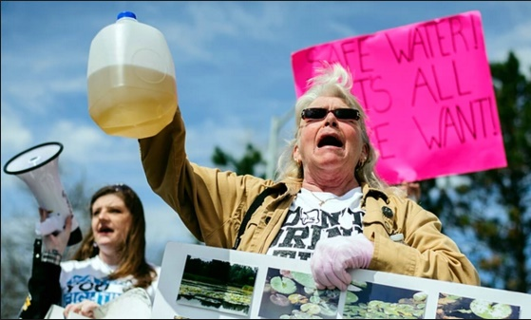
Flint, Michigan Signature case of 21st century environmental injustice in the United States
Abayomi Azikiwe
Regina H. Boone—Detroit Free Press/ZumaPress
Sephia8 – mlive.com
Sam Owens/AP

Slide 3
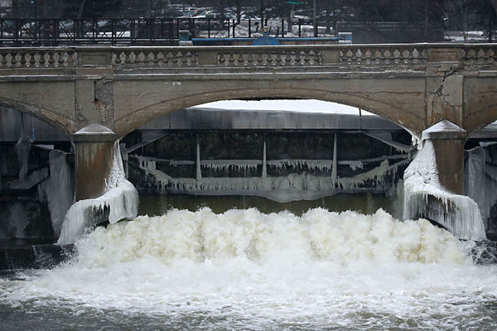
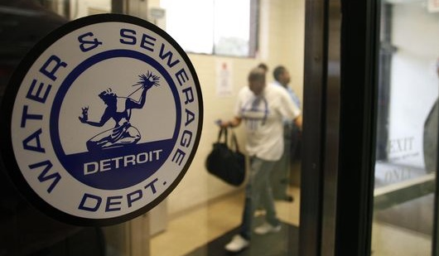
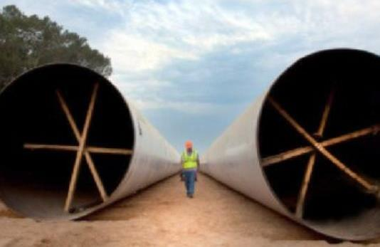

Historic Flint Drinking Water Source
Flint River – Drinking Water Source: April 25, 2014
AP/Paul Sancya
Pipeline to Lake Huron – Projected Completion: Late 2016
Detroit Free Press
Samuel Wilson/The Flint Journal

Slide 4
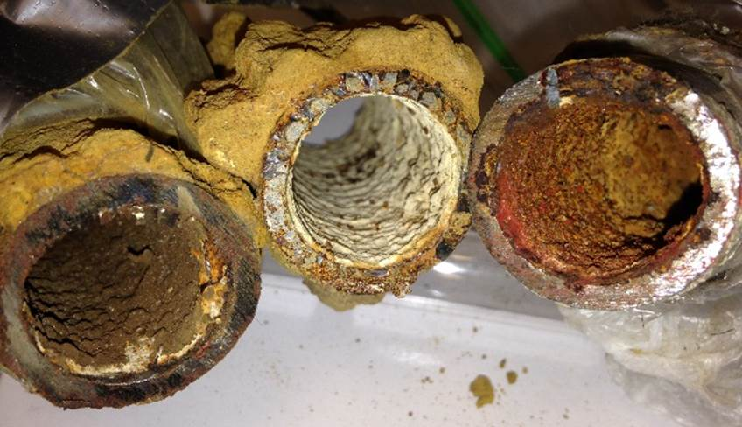

Slide 5
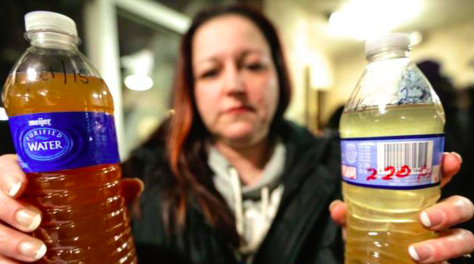
RYAN GARZA/AP

Slide 6
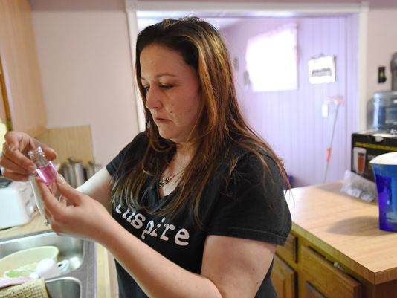
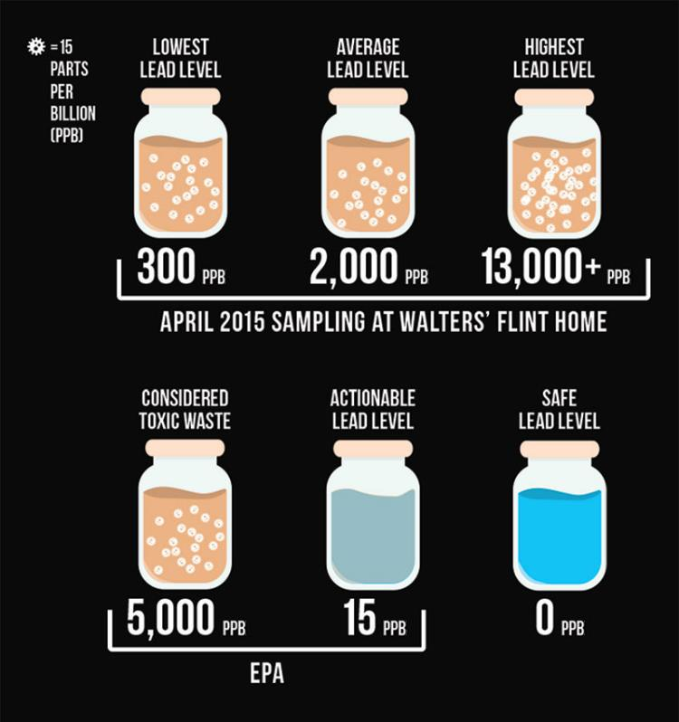
Resident Zero

Slide 7
April 2014: Flint discontinued corrosion control
Water flow without corrosion inhibitors
Mobilization of corrosion rust layers
Lead pipe
Pieper et al.

Slide 8
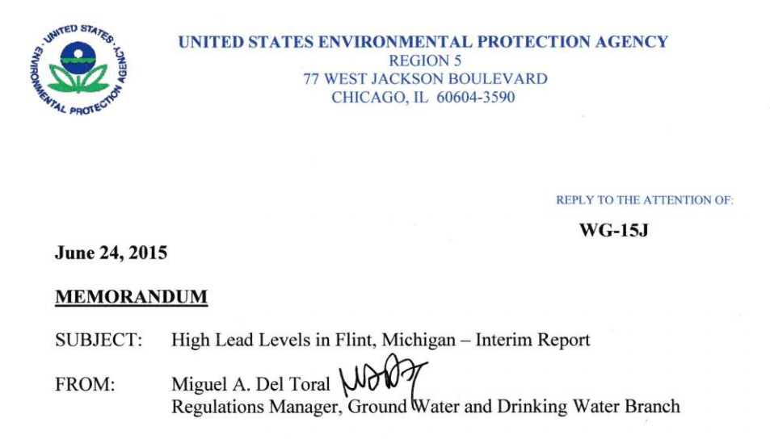
Late June 2015
EPA Memo from Miguel Del Toral
“A major concern from a public health standpoint is the absence of corrosion control treatment in the City of Flint”
Miguel Del Toral memo (2015) available at www.flintwaterstudy.org

Slide 9
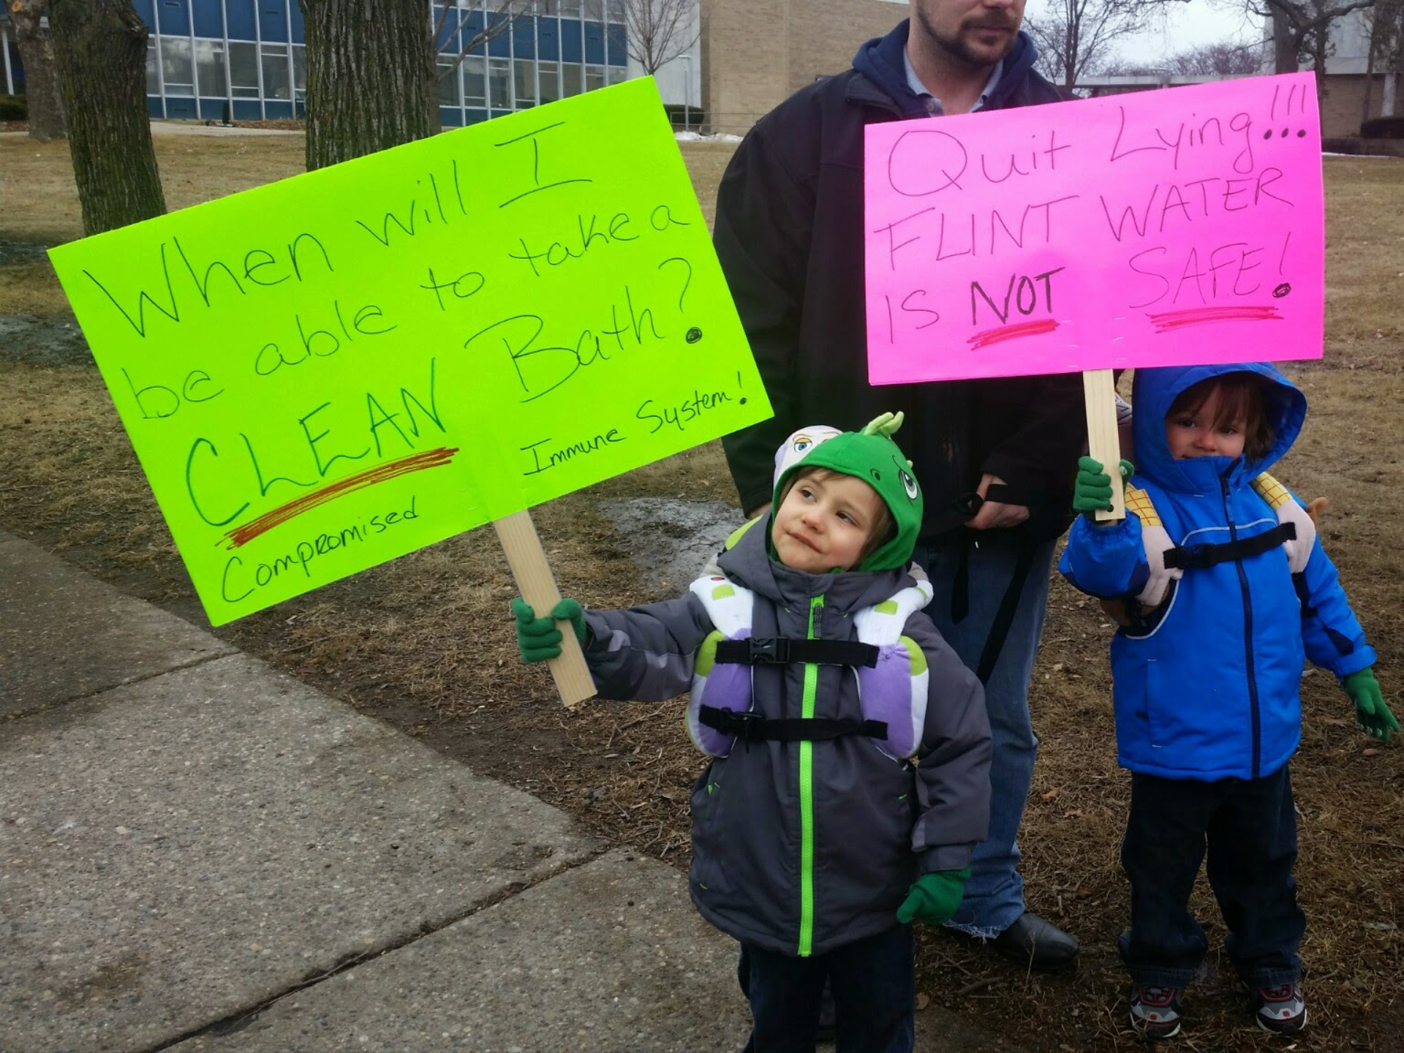
Getty Images

Slide 10
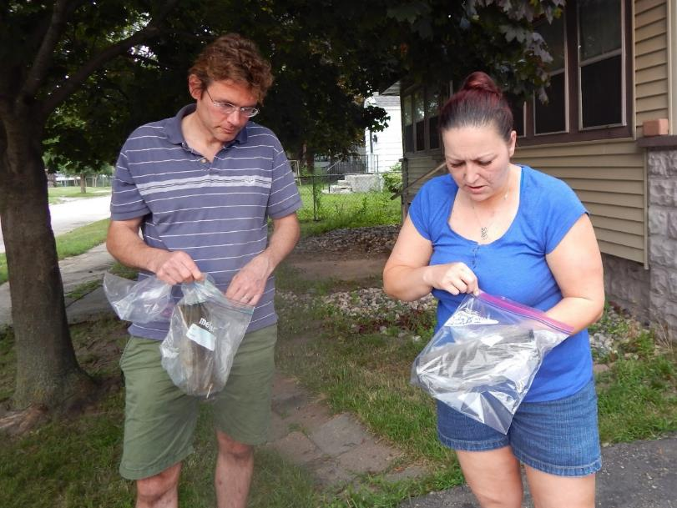
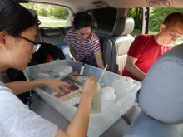
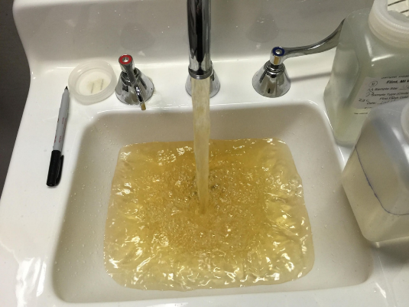
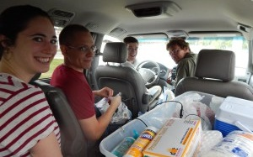
At a Flint hospital

Slide 11
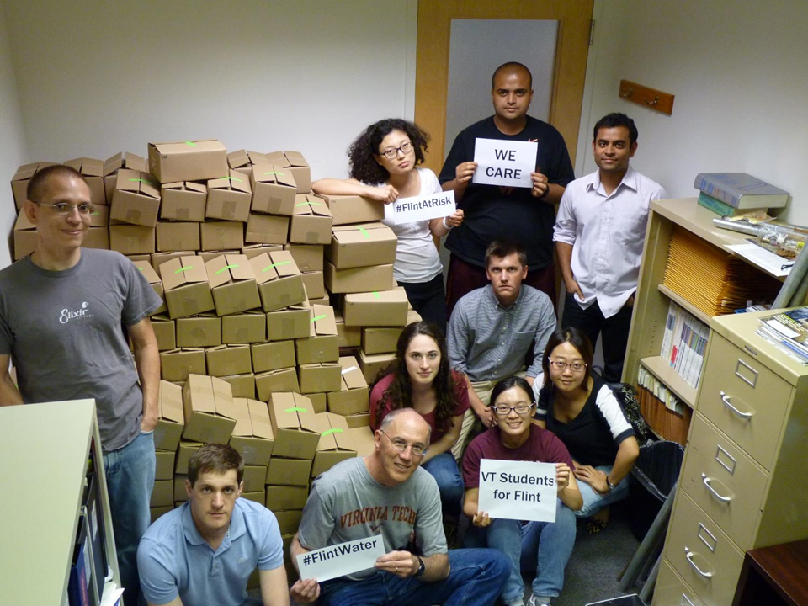
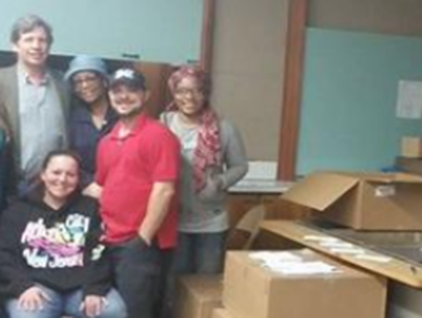
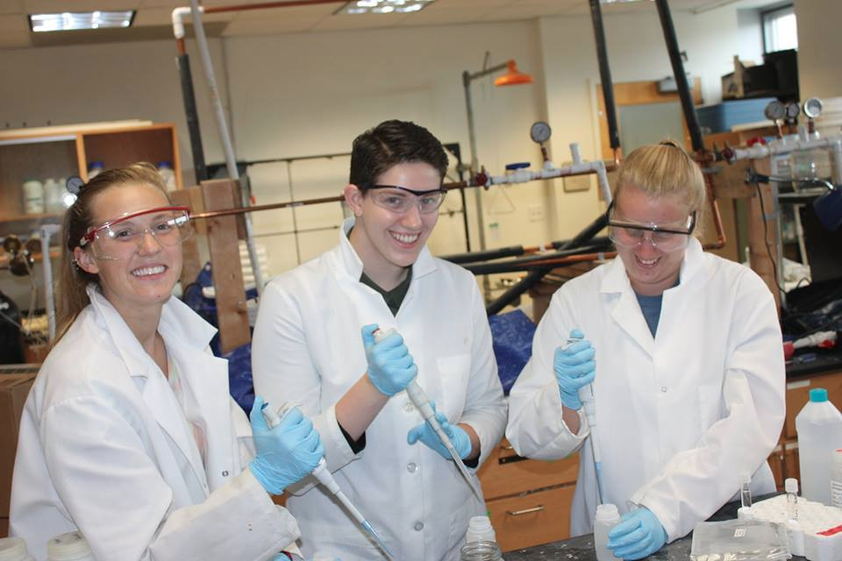
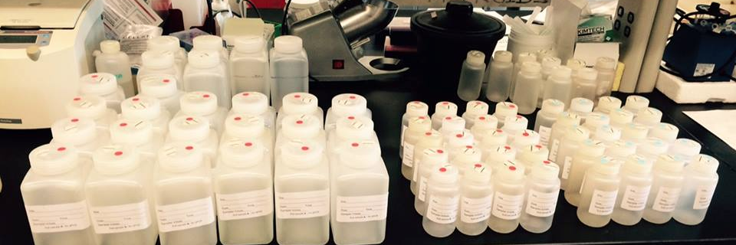

Triumph of good citizen science!
300 water kits sent in August 2015
Flint residents sampling with Virginia Tech.
90% Return Rate: FOUND HIGH LEAD!

Slide 12
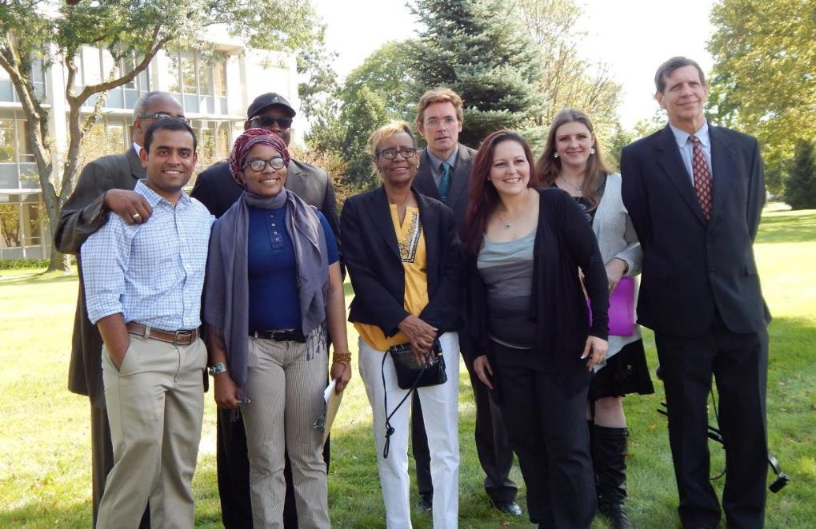
Public Health Advisory Press Conference
September 15 2015
FLINT MI, Sep 2015

Slide 13
Response from Michigan Dept. of Environmental Quality
“This group specializes in looking for high lead problems. They pull the rabbit out of that hat everywhere they go. Nobody should be surprised when the rabbit comes out of the hat, even if they can’t figure out how it is done”
- Brad Wurfel
MDEQ Communications Director

Slide 14


Slide 15
Siddhartha Roy
Virginia Tech Research Scientist and co-leader (with Dr. Marc Edwards) of the whistleblowing Flint Water Study research team

Slide 16
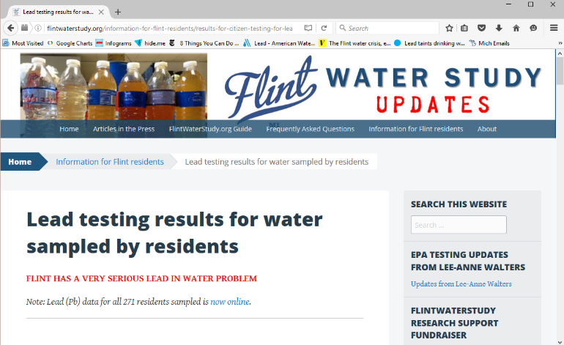
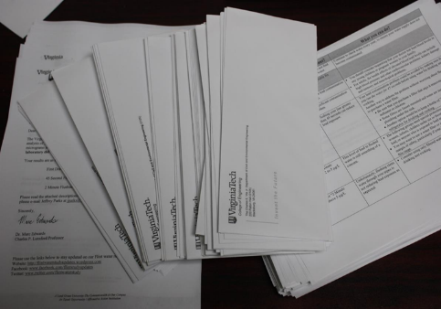
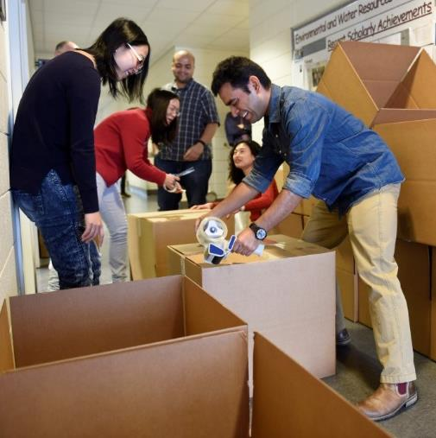
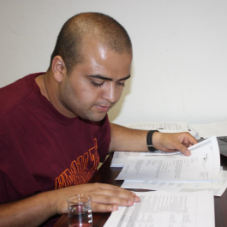
www.flintwaterstudy.org
STUDENTS WORKING OVER OVERTIME AND COMMUNICATING DIRECTLY WITH RESIDENTS
Website/Facebook/Twitter/Letters/Phone calls

Slide 17
Oct-Dec 2015: Reconnected to Detroit and added extra corrosion treatment (>3 mg/L PO4)
Water flow with corrosion inhibitors
Form new
corrosion scales
Lead pipe
Pieper et al.

Slide 18

https://twitter.com/thedailyshow/status/688131499615363074

Slide 19
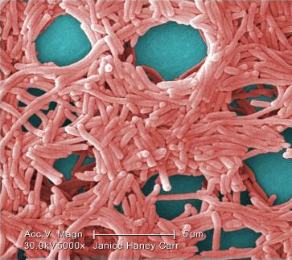
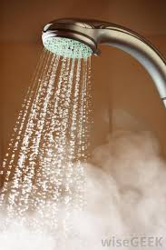
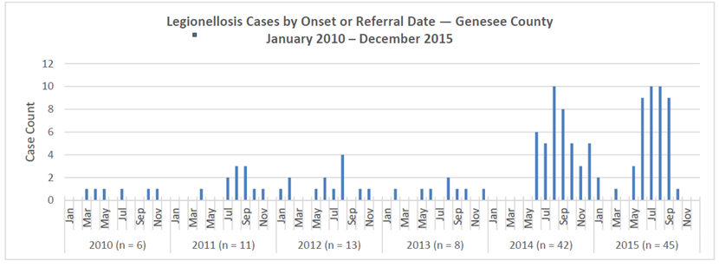
Legionnaires’ Outbreaks ~ 91 cases; at least 13 deaths
Flint Water
Switch
Rhoads et al., 2017 ES&T

Slide 20
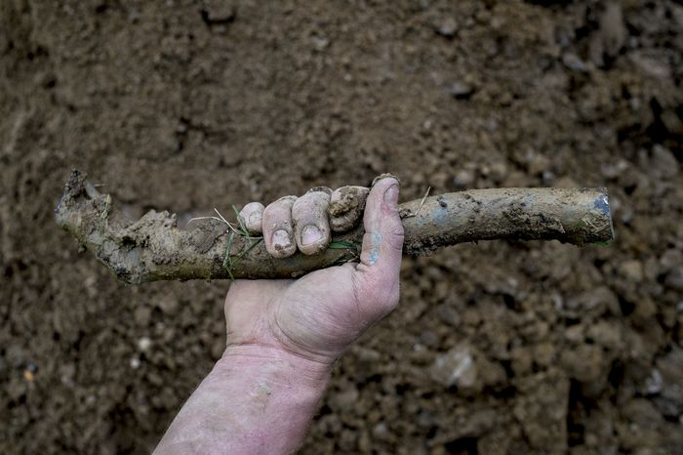
$1.2 billion in relief, including
$100 mn for lead pipe replacements and
$626 mn class action settlement for Flint children
Jake May; https://www.cityofflint.com/gettheleadout/
Notes:
After switchback, enhanced corrosion control and 80%+ service pipes replaced: lead in biosolids, water lead, and children’s blood, in Flint are at historic lows (2019).

Slide 21
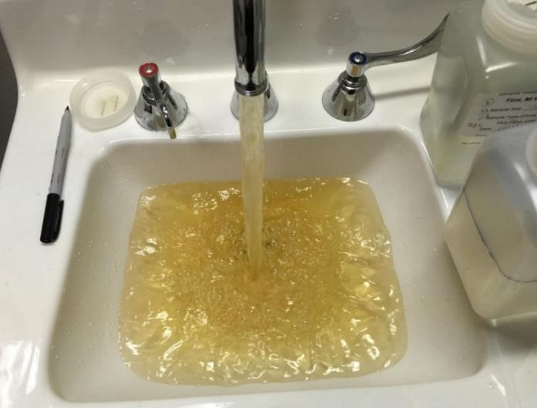
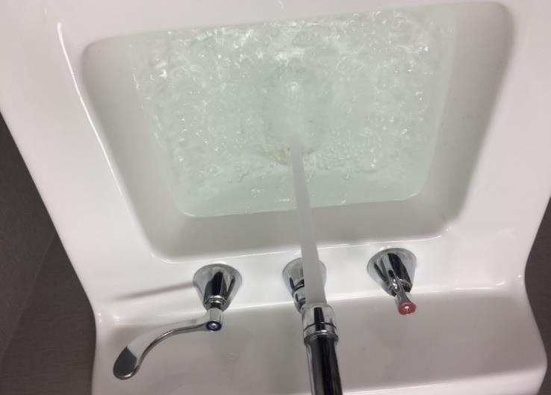
Flint Hospital 2015 vs. 2016
2015: Flint River without Corrosion Control
2016: Detroit Water with Enhanced Corrosion Control
Photographs: Zhu “Joyce” Ni, Min Tang, Pan Ji, Mariah Gnegy

Slide 22
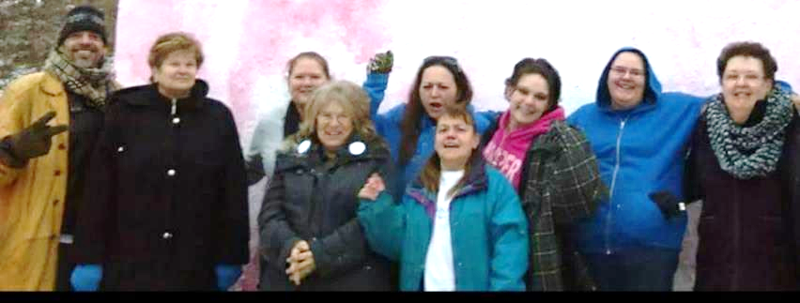
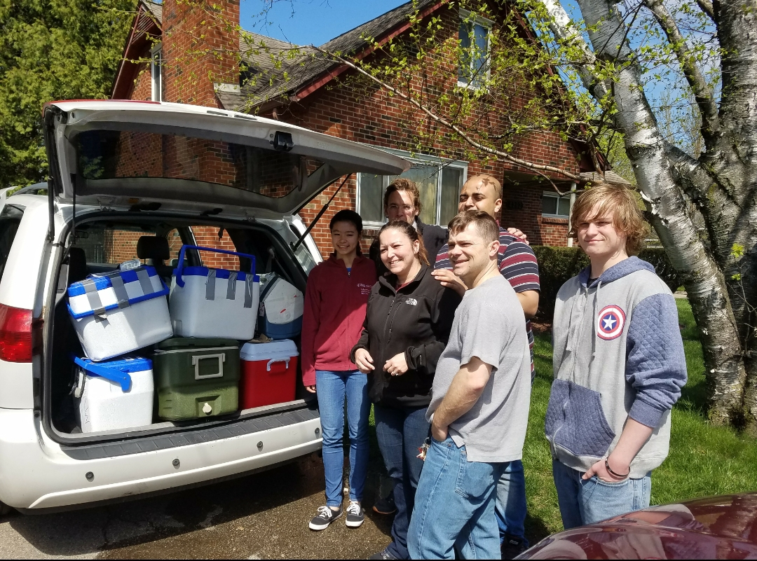
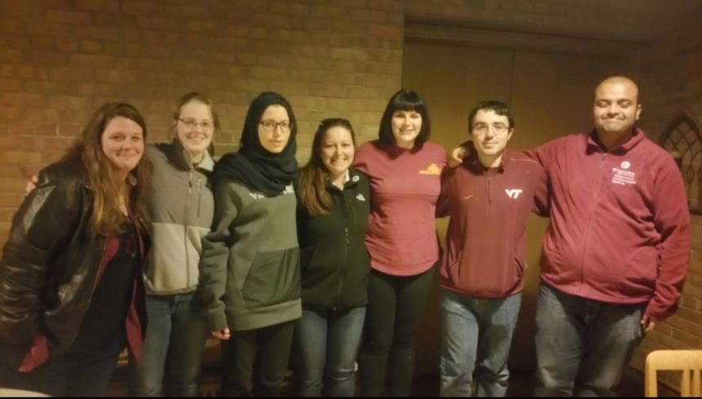
Flint citizen teams led five rounds of lead testing between Aug 2015-Aug 2017 and chlorine testing between Aug 2015-Oct 2019

Slide 23
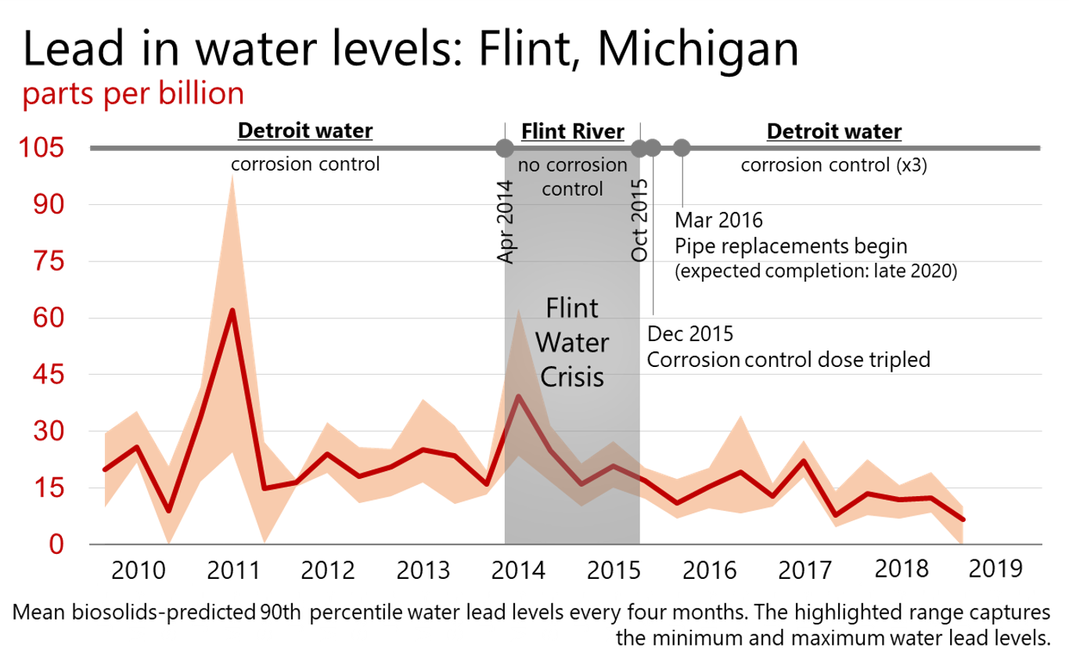
Roy et al., Water Research, 2019
Notes:
Lead in water and children’s blood is at historic lows

Slide 24
MDEQ/City of Flint Cheated on Lead Monitoring
ACTUALLY FAILED W/ 71 SAMPLES
NOW PASSED! W/ 69 SAMPLES
Notes:
Sid talks about scientific misconduct
Cheating on lead sampling in Flint
At least 33 US cities use faulty sampling; e.g. Philly

Slide 25
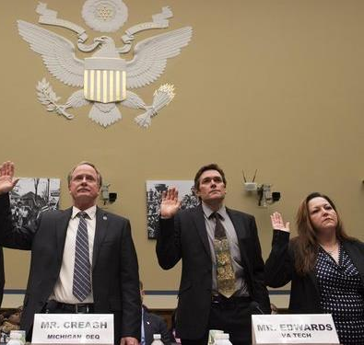
Testifying to Congress – Bringing attention to Flint and voicing changes to the Lead and Copper Rule

Slide 26
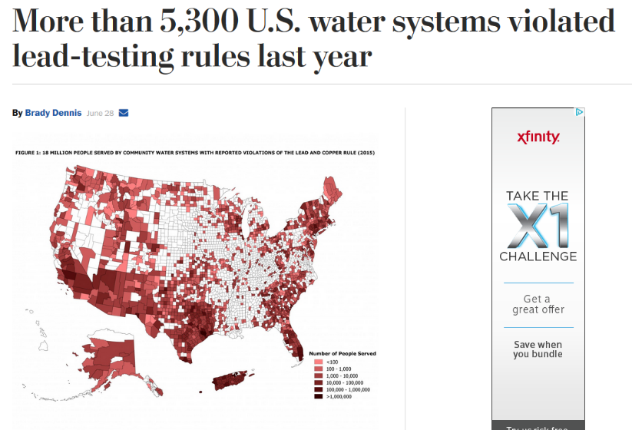

Notes:
Nationally, over 5,000 water systems were found in violation. Newark NJ was recently in the news for high lead levels.
Millions on private wells.

Slide 27
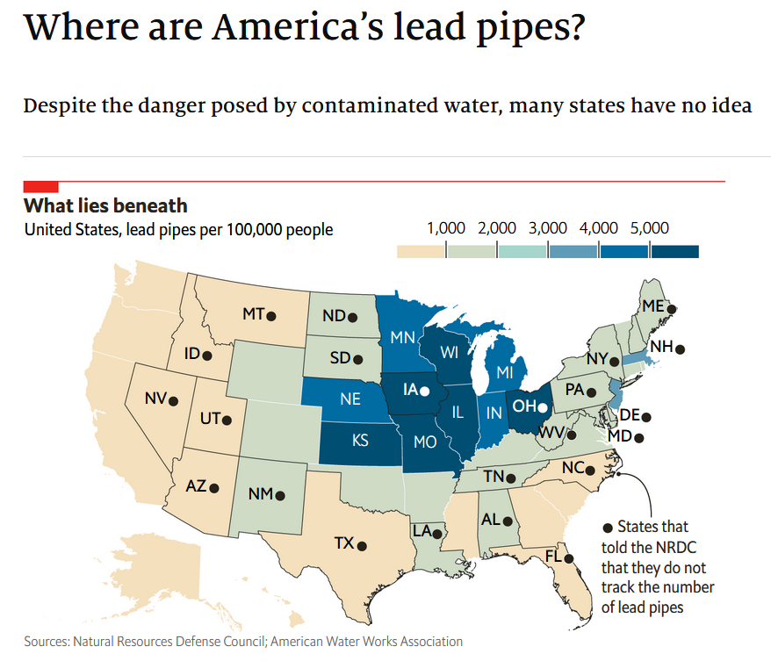
Notes:
6-10 million lead pipes in the country.
Every major US city has homes with old lead pipes: Flint, Washington DC, Detroit, New Orleans, Chicago – esp. in the Midwest and Northeast.

Slide 28
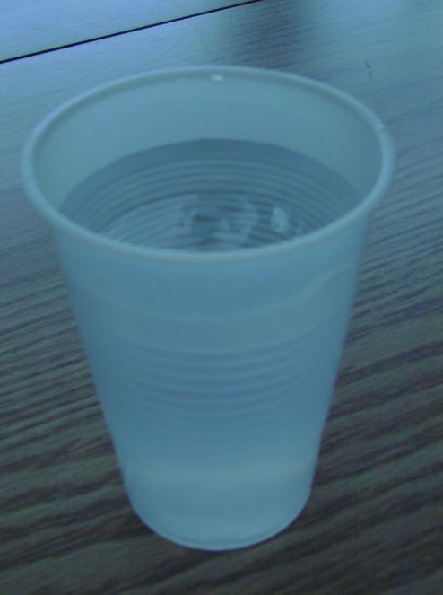
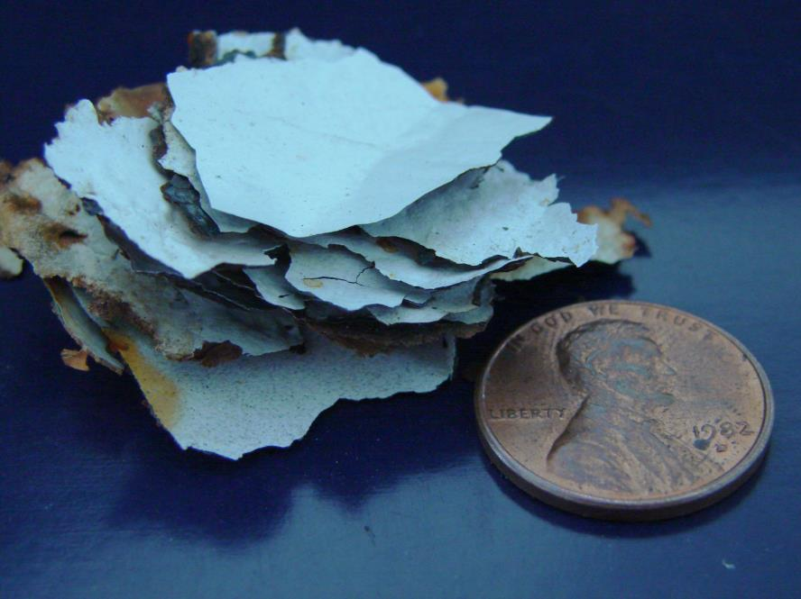
Pb in water vs. Pb in paint
250 mL at 20,000 ppb Pb
14 dime size paint chips 1% Pb
Both have 5,000 ug lead
Notes:
Pernicious thing about lead is it cannot be tasted, smelled, or seen as this visual shows.
15 ppb EPA’s Lead Action Level but when we see water lead consistently above 5 at the tap, we begin to worry.

Slide 29
“We must always take sides. Neutrality helps the oppressor, never the victim. Silence encourages the tormentor, never the tormented.” – Elie Wiesel (Holocaust Survivor/Nobel laureate)

